Slide 1
Current Trends on Wearable Devices
15 Oct 2025, Bhanu Prakash B
bhanu.b@capgemini.com

Slide 2
Agenda
Wearables Intro – 60 Minutes
01
What are wearable devices?
Evolution and History
Key Components
AI and Machine Learning Integration
Q&A and Interaction – 30 Minutes
02
Q&A
Interaction
Wearable Devices Session with First Year Engineering Students, VIT – 90 Minutes

Slide 3

What are Wearable Devices?
Electronic devices that can be worn on the body, either as accessories or embedded in clothing, that perform useful computing tasks.
Key Characteristics
Portable and hands free
Continuous operation
Connected to other devices
Context aware
User centric design
Common Examples
Smartwatches
Fitness trackers
Smart glasses
Smart rings
Health monitors
Smart clothing

Slide 4
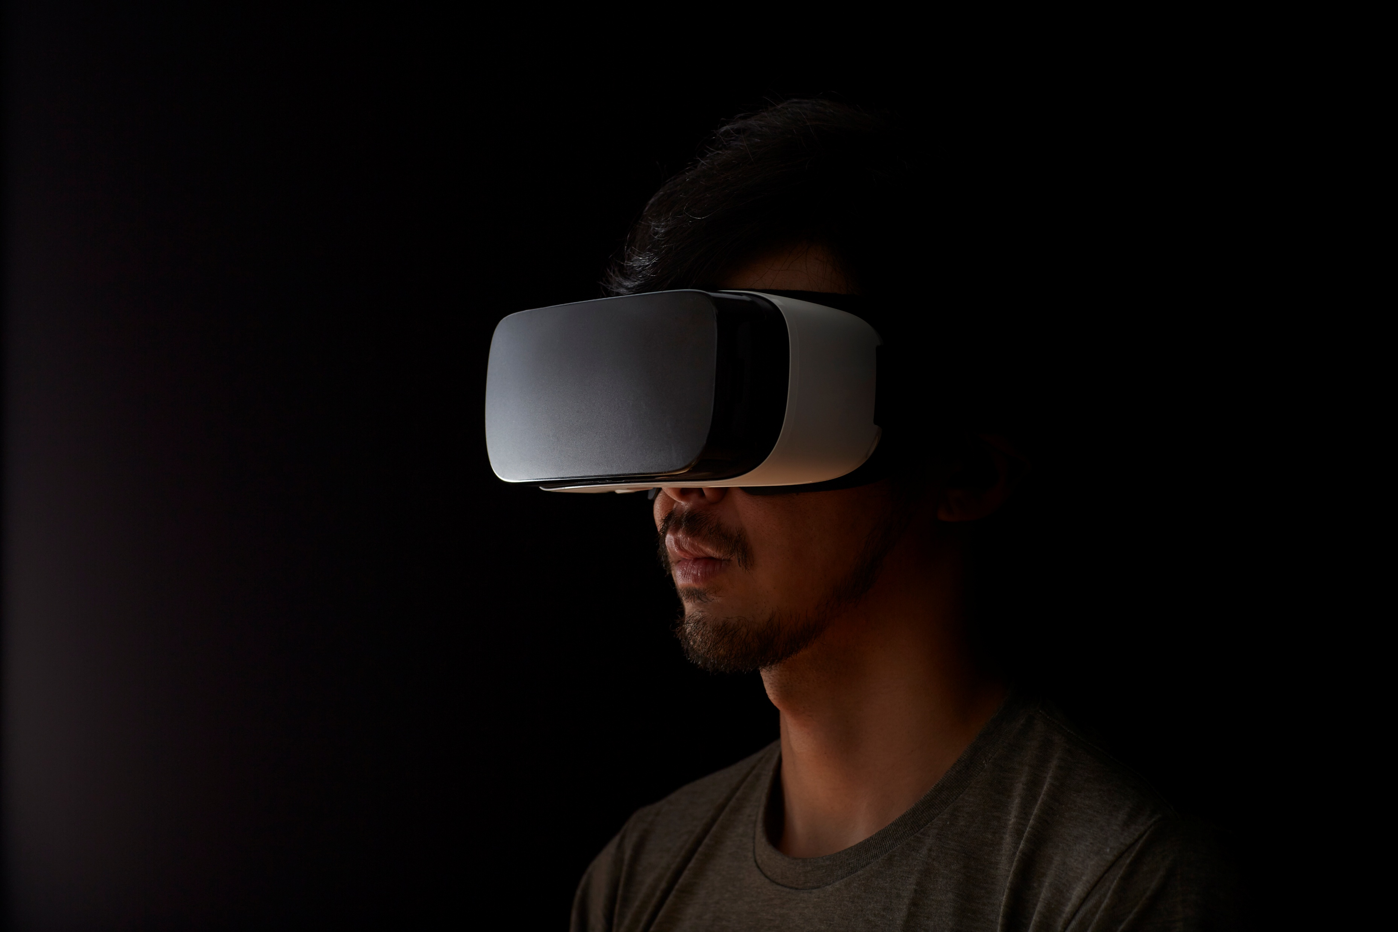
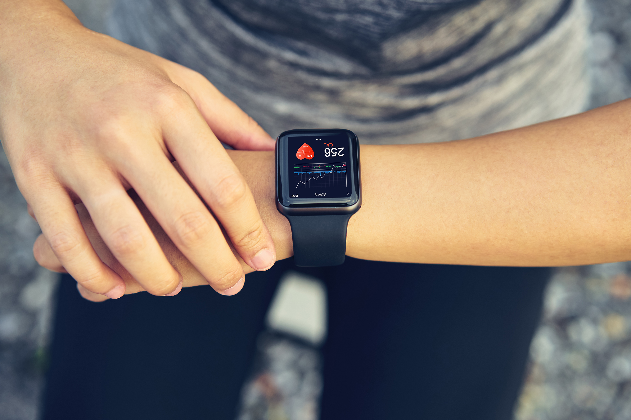
Evolution and History
1960s 1980s:
Calculator watches, digital watches
1990s 2000s:
Bluetooth headsets, early fitness trackers (pedometers)
2010 2015:
Fitbit, Pebble smartwatch, Google Glass, Apple Watch
2016 2020:
Advanced health monitoring, ECG sensors, continuous glucose monitors
2021 Present:
AI integration, advanced biometrics, AR glasses, brain computer interfaces

Slide 5
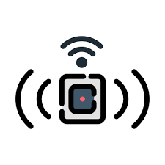
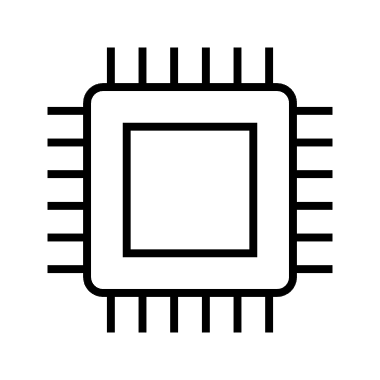


Key Components
Processing
Low power microcontrollers
Edge AI processors
System on Chip (SoC)
Sensors
Accelerometer, gyroscope
Heart rate, SpO2
Temperature, pressure
Power
Lithium ion batteries
Energy harvesting
Wireless charging
Connectivity
Bluetooth Low Energy
Wi Fi, NFC
Cellular (LTE, 5G)

Slide 6
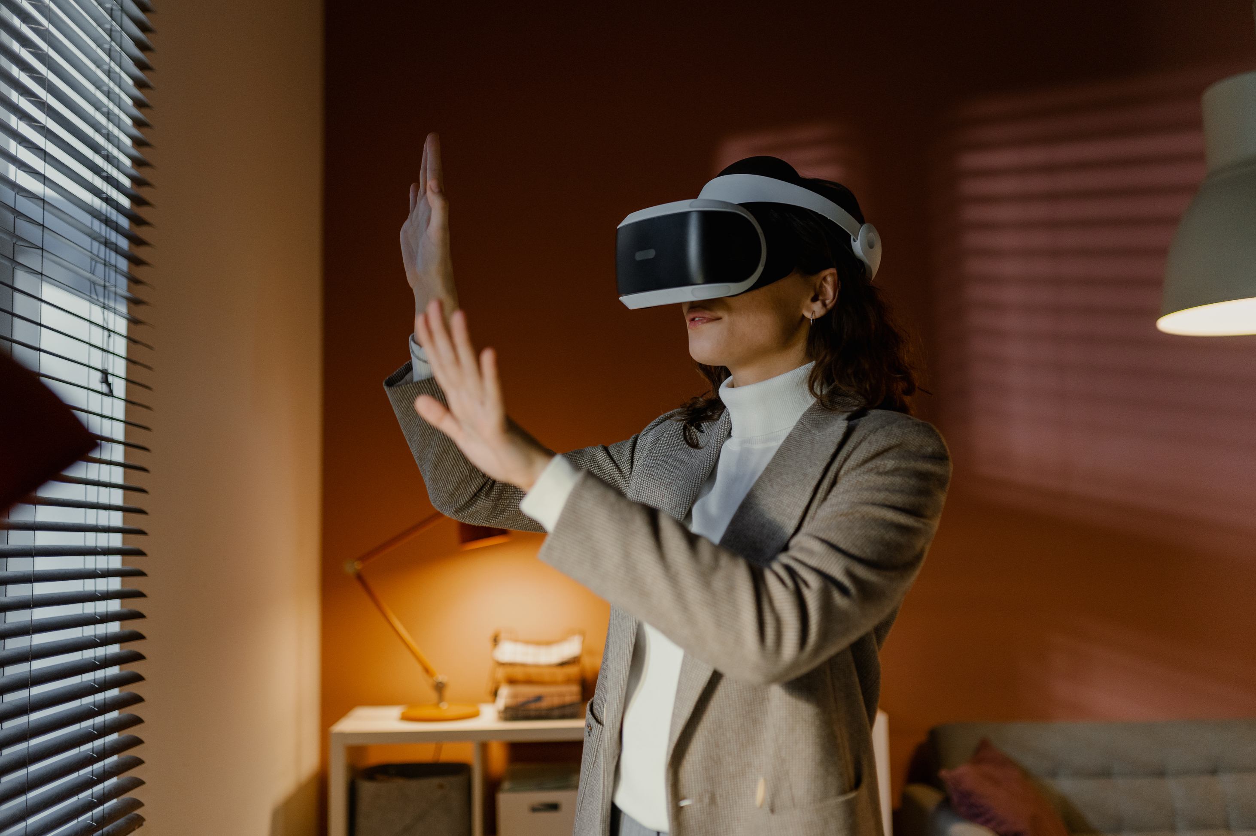
AI and Machine Learning Integration
Personalized Insights:
Activity and sleep pattern recognition
Predictive health alerts
Adaptive coaching and recommendations
Computer Vision
Gesture recognition
Object and face recognition
Real-time scene understanding
Voice Assistants
Hands-free control and queries
Natural language processing
Context-aware responses

Slide 7
Q&A and
Interaction

